Slide 1
Battle of neighborhoods
Poobathi Subramani
2020 Feb

Slide 2
Agenda
Business Problem
Data Acquisition and Preparation
Findings
Conclusion

Slide 3
Business Problem
This presentation discusses about comparing the business opportunity provided by two major cities – New York, USA and Toronto Canada. This is to support a decision making process of establishing a restaurant in one of these cities. Appropriate statistical methods and models have been adopted to analyze the data and visualize the data. A conclusion was arrived based on the results found in the analysis and visualization.

Slide 4
Data Acquisition and Preparation
Data has been acquired from the following sources
Foursquare - is the major source of my analysis as it provides all the venues around the neighborhoods. This source is capable of providing lot of additional information like ratings etc. but for this analysis, I will be focusing at the high level and using the appropriate level of data that can be obtained with a regular membership
Wiki - This is another lake of source. I will be using this to get the initial list such as zip/postal codes, boroughs etc.
Toronto Neighborhood https://en.wikipedia.org/wiki/List_of_postal_codes_of_Canada:_M
Other sites - to get information like demographics etc.
NY City Zip https://public.opendatasoft.com/explore/dataset/us-zip-code-latitude-and-longitude/table/
NY zip code Mapping https://www.health.ny.gov/statistics/cancer/registry/appendix/neighborhoods.htm

Slide 5
Findings
New York
7000+
Toronto
4000+
Total Venues

Slide 6
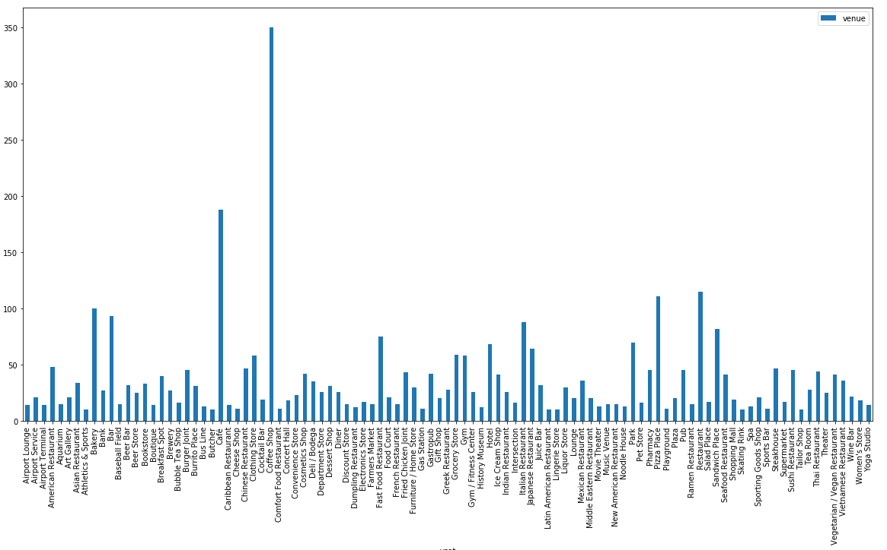
Toronto – Distinct Venues

Slide 7
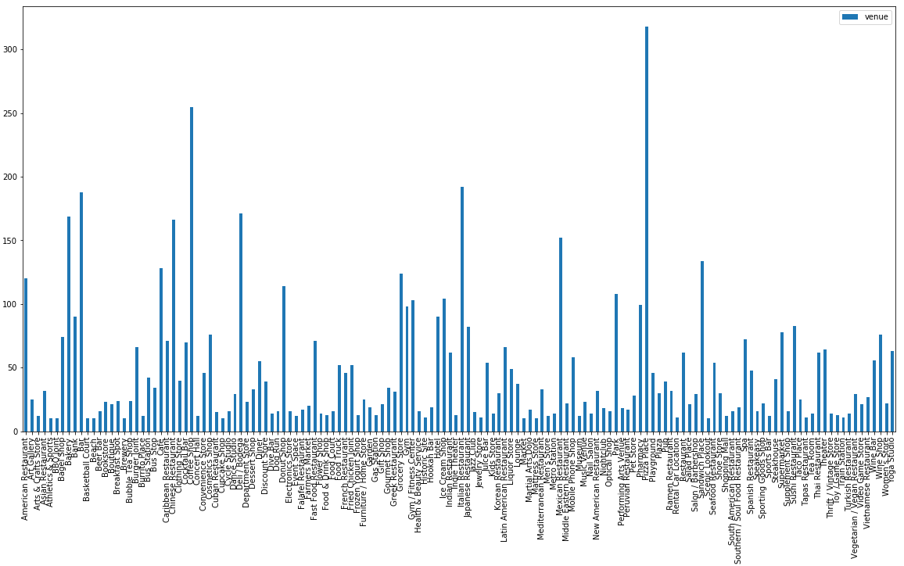
New York - Distinct Venues

Slide 8
Findings
New York
3000+
Food Related Venues
Toronto
1000+

Slide 9
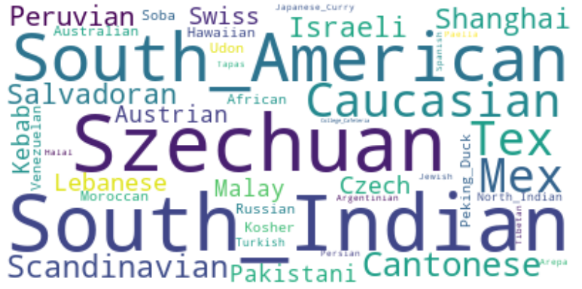
Cuisines in New York that are not in Toronto

Slide 10

Cuisines in Toronto that are not in New York

Slide 11
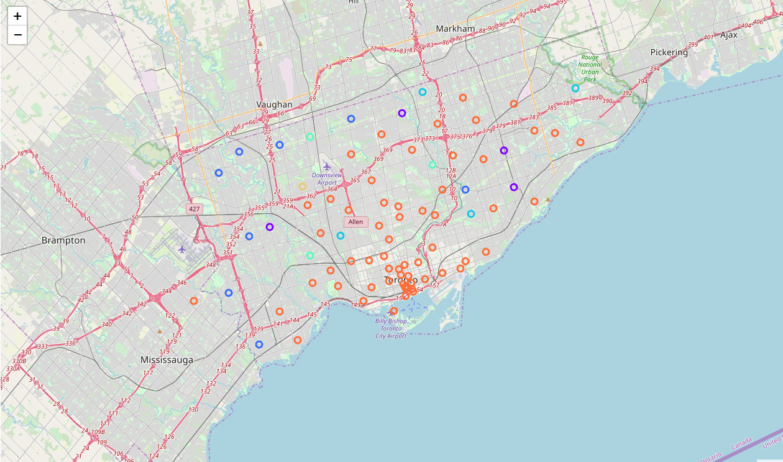
Categorization of Restaurants in Toronto

Slide 12
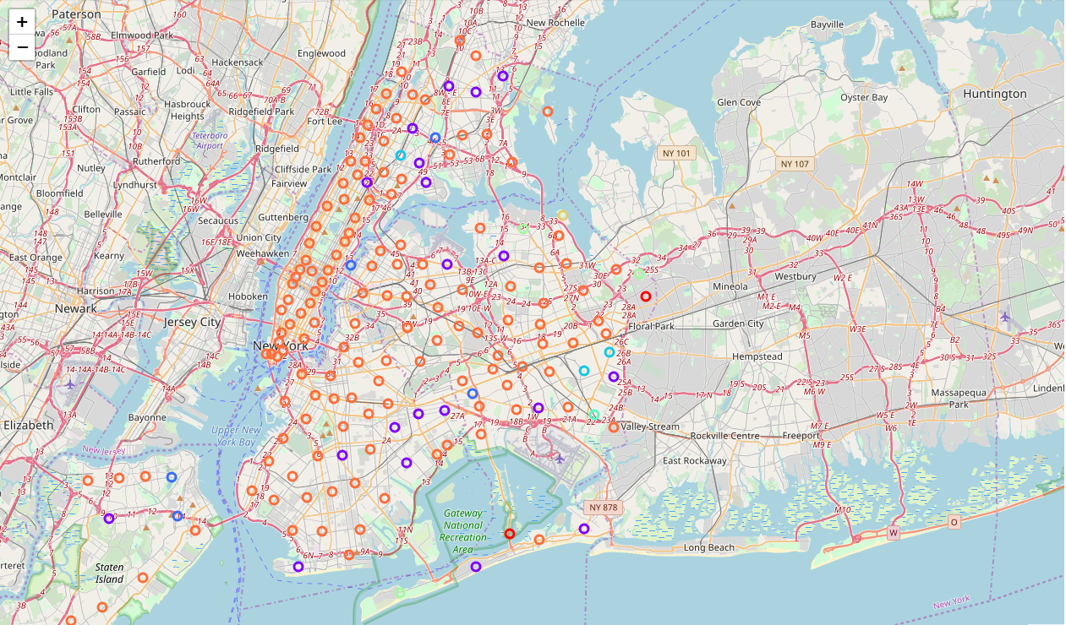
Categorization of Restaurants in New York

Slide 13
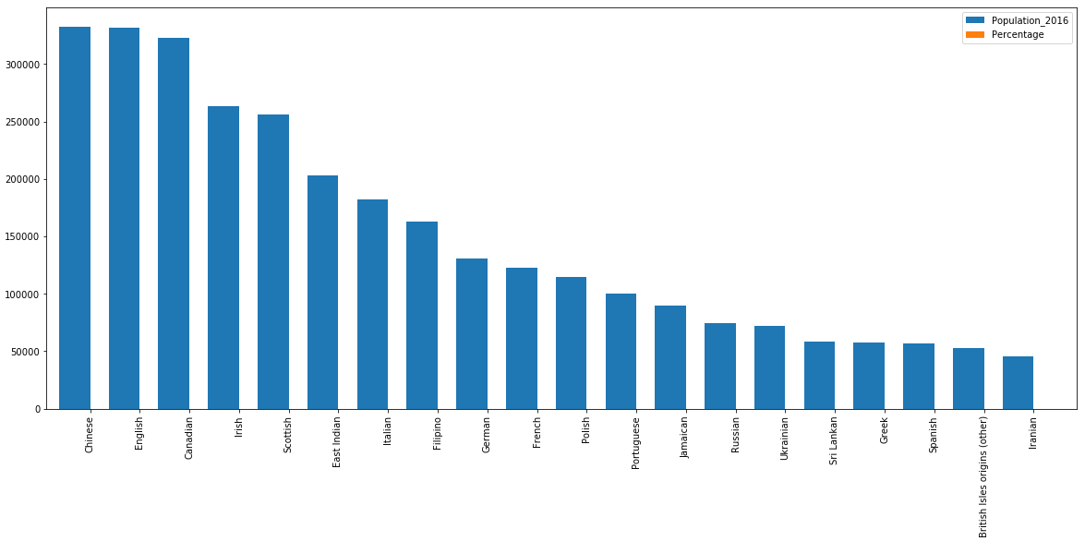
Toronto Population by Ethnicity

Slide 14
New York vs Toronto
A Quick View
Both cities are largest in their countries
Both are Financial and Tourist capitals in their countries
Both are having high cost of living
Both cities are having good network of commutation – subways, busses
Both cities are sharing a similar weather though TO is slightly colder than NY
Multi Ethnic

Slide 15
Conclusion
Recommendation is to establish a Specialty Cuisine in Toronto
While New York and Toronto both has variety of options, as far as the food related venues are concerned, Canada has lesser options comparatively
The distribution of regular-restaurants are dense in the Toronto but the suburbs are not that clustered so that can be considered to the location
Canada is also a multi-ethnic city, so it also would help run a successful business

